Slide 1


CMR TECHNICAL CAMPUS UGC (Autonomous) Kandlakoya, Medchal Road, Hyd-501401 Department of Computer Science and Engineering
A
Mini Project On
Missing Child Identification System using Deep Learning and Multiclass SVM
BATCH NO: 11
GROUP MEMBERS :
207R1A0569 B. Vedika
207R1A0561 A. Harshitha Naidu
207R1A0565 B. Ashok
UNDER THE GUIDENCE OF:
Dr . J. Narasimharao
(Associate Professor)

Slide 2
ABSTRACT
In India a countless number of children are reported missing every year. Among the missing child cases a large percentage of children remain untraced.
This paper presents a novel use of deep learning methodology for identifying the reported missing child from the photos of multitude of children available, with the help of face recognition.
The Convolutional Neural Network (CNN), a highly effective deep learning technique for image based applications is adopted here for face recognition.
Face descriptors are extracted from the images using a pre-trained CNN model VGG-Face deep architecture. Compared with normal deep learning applications, our algorithm uses convolution network only as a high level feature extractor and the child recognition is done by the trained SVM classifier.

Slide 3
EXISTING SYSTEM
The child missing from one region may be found in another region or another
state, for various reasons. So even if a child is found, it is difficult identify
him/her from the reported missing cases.
A framework and methodology for developing an assistive tool for tracing
missing child is described in this paper.
An idea for maintaining a virtual space is proposed, such that the recent
photographs of children given by parents at the time of reporting missing cases is
saved in a repository.

Slide 4
Limited data availability
Lack of standardization
Dependency on police reports
Regional limitations
Lack of privacy protection
DISADVANTAGES
OF
EXISTING SYSTEM

Slide 5
PROPOSED SYSTEM
Whenever public uploads photo of a suspected child, the system generates template
vector of the facial features from the uploaded photo. If a matching is found in
the repository, the system displays the most matched photo and pushes a message
to the concerned Officer portal or SMSs the alert message of matching child.
This method executed using features extracted employing a CNN network for
getting facial representations

Slide 6
ADVANTAGES OF PROPOSED SYSTEM
The use of multiclass SVM in the system improves the accuracy of classification and reduces false positives, leading to a more reliable identification process.
The proposed system is incredibly easy,
inexpensive and reliable method while
compared to other biometrics systems
like fingerprint recognition.

Slide 7
SYSTEM REQUIREMENTS
HARDWARE REQUIREMENTS:
Processor : Pentinum IV or higher
RAM : 256 MB
Hard Disk : 5 MB (min)
SOFTWARE REQUIREMENTS:
Operating system : Windows 8 ultimate
Coding language : Python
Front-End : Python
Back-End : Django
Data Base : Mysql (WAMP Server)
Debugger and Emulator : Any Browser (particularly chrome)

Slide 8
NOVELTY
The approached solution uses Convolutional Neural Network (CNN), for face recognition in the identification of
missing children. This is a novel application of deep learning in the domain of missing child identification.
The proposed system also utilizes a multiclass SVM for classification of the input child image, which improves
the accuracy of classification and reduces false positives.
The proposed deep learning model is trained to be invariant to noise, illumination, contrast, occlusion, image pose,
and age of the child, making it more robust and effective in identifying missing children.
Our solution provides a easy, inexpensive and reliable method while compared to other systems.

Slide 9
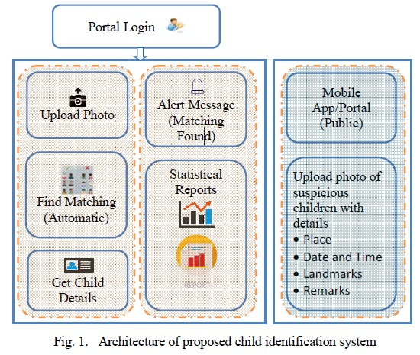
ARCHITECTURE

Slide 10
MODULES
Preprocessing
Upload Photo
Search

Slide 11
PREPROCESSING
Preprocessing input raw image in the context of face recognition involves acquiring the face region and standardizing images in a format compatible with the CNN architecture employed.
Each CNN has a different input size requirement.
The photographs of missing child acquired by a digital camera or mobile phone are taken and categorized into separate cases for creating the database of face recognition system.
The face region in each image is identified and cropped for getting the input face images.

Slide 12
UPLOAD PHOTO
It consists of a national portal for storing details of missing child along with the photo.
Whenever a child missing is reported, along with the FIR, the concerned officer uploads the photo of the missing child into the portal.
The public can upload photo of any suspicious child at any time into the portal with details like place, time, landmarks and remarks. The photo uploaded by the users will be automatically compared with photos of the registered missing children and if a matching photo with sufficient score is found, then an alert email will be sent to the concerned officer.
The message will also be visible in the message box of the concerned officer login screen.

Slide 13
SEARCH
Whenever users uploads photo of a suspected child, the system generates template vector of the facial features from the uploaded photo.
If a matching is found in the repository, the system displays the most matched photo and pushes a message to the concerned Officer portal or Email the alert message of matching child.
Similarly the Officer can check for any matching with the database at any time using the proposed system.

Slide 14
UML DIAGRAMS
Use Case Diagram
Class Diagram
Sequence Diagram
Activity Diagram

Slide 15
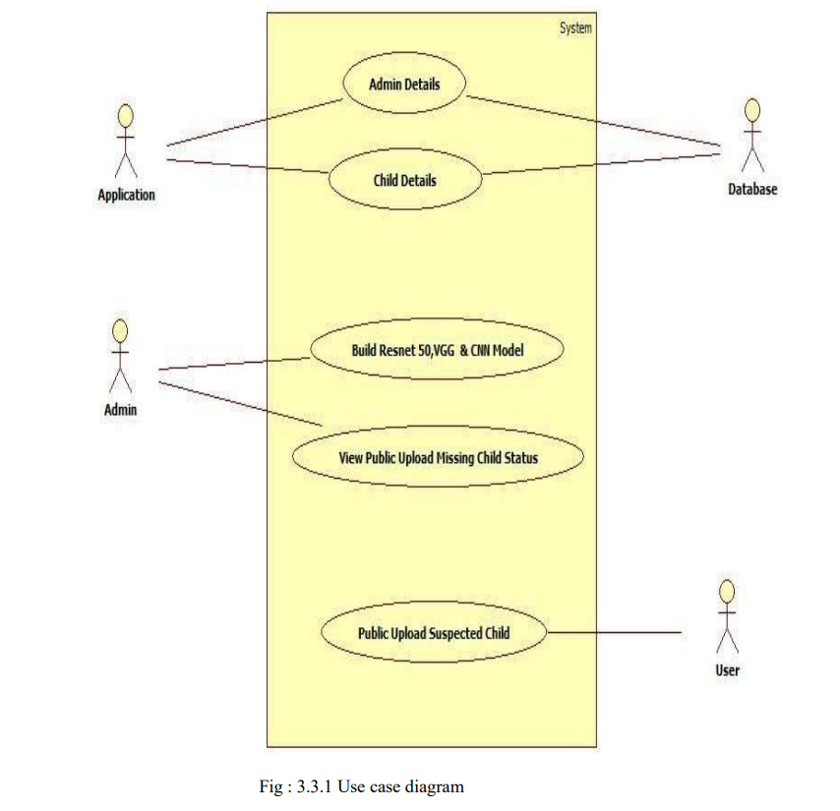
USE CASE DIAGRAM

Slide 16
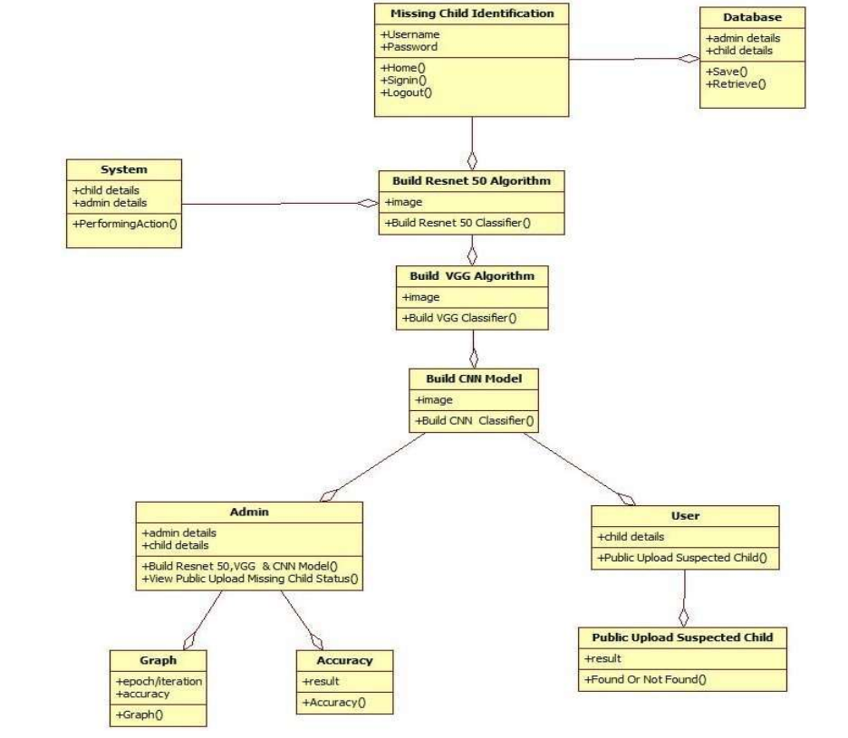
CLASS DIAGRAM

Slide 17
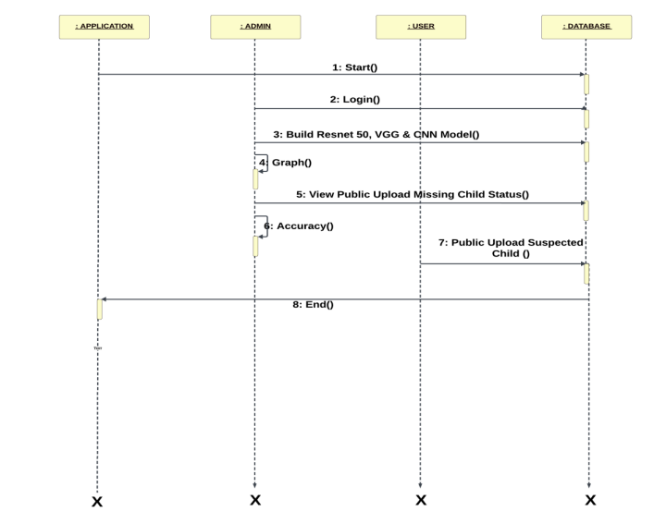
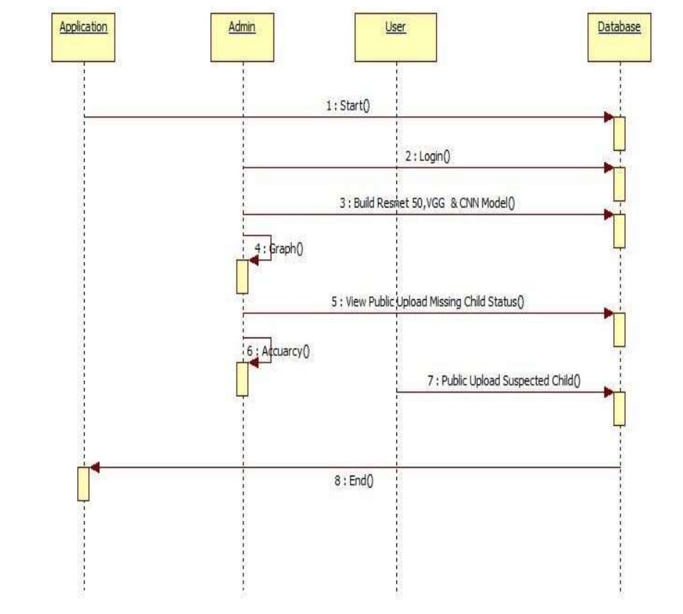
SEQUENCE DIAGRAM

Slide 18
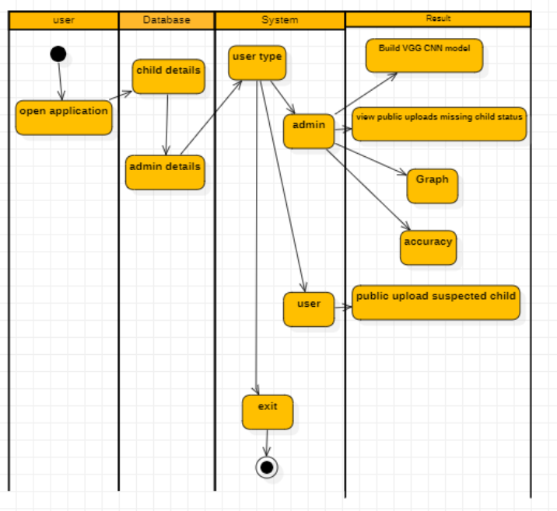
ACTIVITY DIAGRAM
`

Slide 19
SAMPLE CODE
from django.shortcuts import render
from django.template import RequestContext
import pymysql
from django.http import HttpResponse
from django.conf import settings
from django.core.files.storage import FileSystemStorage
import datetime
import os
import cv2
import numpy as np
from keras.utils.np_utils import to_categorical
from keras.layers import MaxPooling2D
from keras.layers import Dense, Dropout, Activation, Flatten
from keras.layers import Convolution2D
from keras.models import Sequential

Slide 20
def WelfareLoginAction(request):
if request.method == 'POST':
username = request.POST.get('t1', False)
password = request.POST.get('t2', False)
if username == 'welfare' and password == 'welfare':
context= {'data':'welcome '+username}
return render(request, 'WelfareScreen.html', context)
else:
context= {'data':'login failed'}
return render(request, 'WelfareLogin.html', context)
def ParentLoginAction(request):
if request.method == 'POST':
username = request.POST.get('t1', False)
password = request.POST.get('t2', False)
index = 0
con = pymysql.connect(host='127.0.0.1',port = 3308,user = 'root', password = 'root', database = 'MissingChildDB',charset='utf8')
with con:
cur = con.cursor()
cur.execute("select * FROM parentsignup")
rows = cur.fetchall()

Slide 21
for row in rows:
if row[0] == username and password == row[1]:
index = 1
break
if index == 1:
file = open('session.txt','w')
file.write(username)
file.close()
context= {'data':'welcome '+username}
return render(request, 'ParentScreen.html', context)
else:
context= {'data':'login failed'}
return render(request, 'ParentLogin.html', context)
def OfficialLogin(request):
if request.method == 'POST':
username = request.POST.get('t1', False)
password = request.POST.get('t2', False)
if username == 'admin' and password == 'admin':
context= {'data':'welcome '+username}
return render(request, 'OfficialScreen.html', context)
else:
context= {'data':'login failed'}
return render(request, 'Login.html', context)

Slide 22
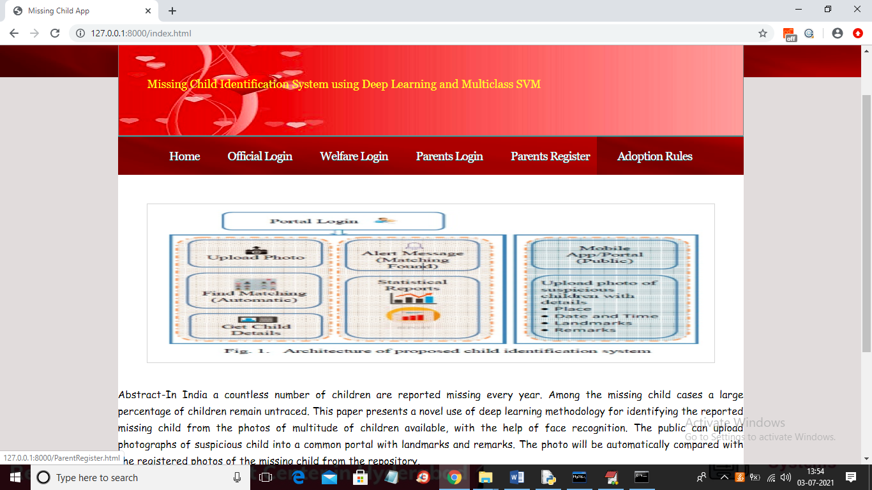
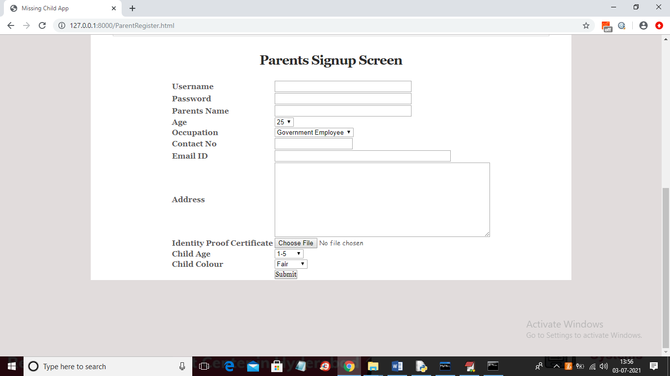
RESULTS

Slide 23
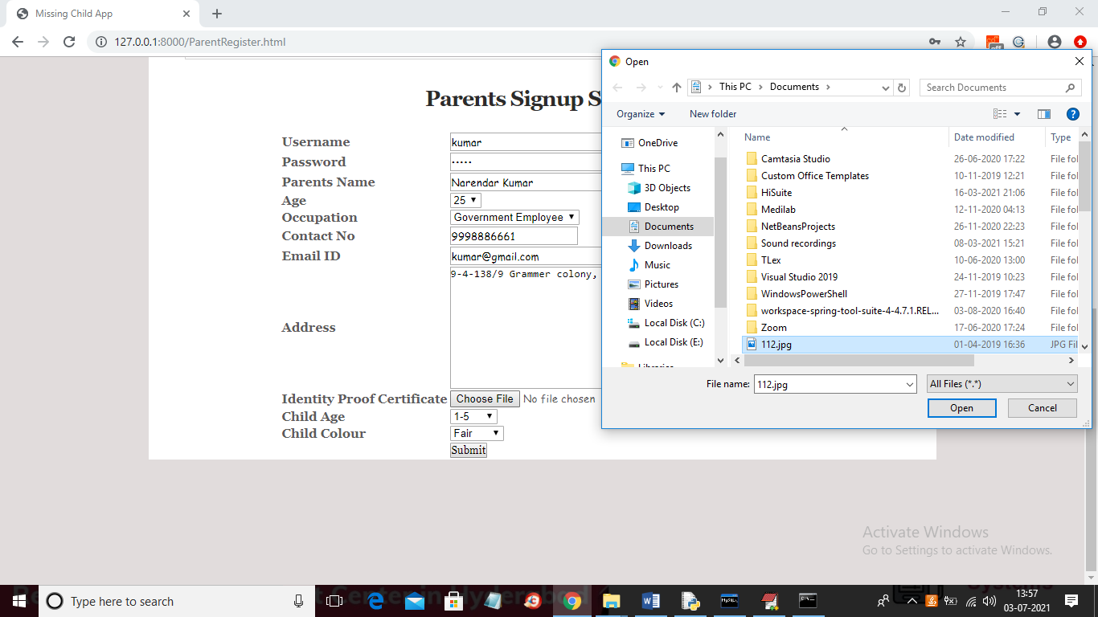
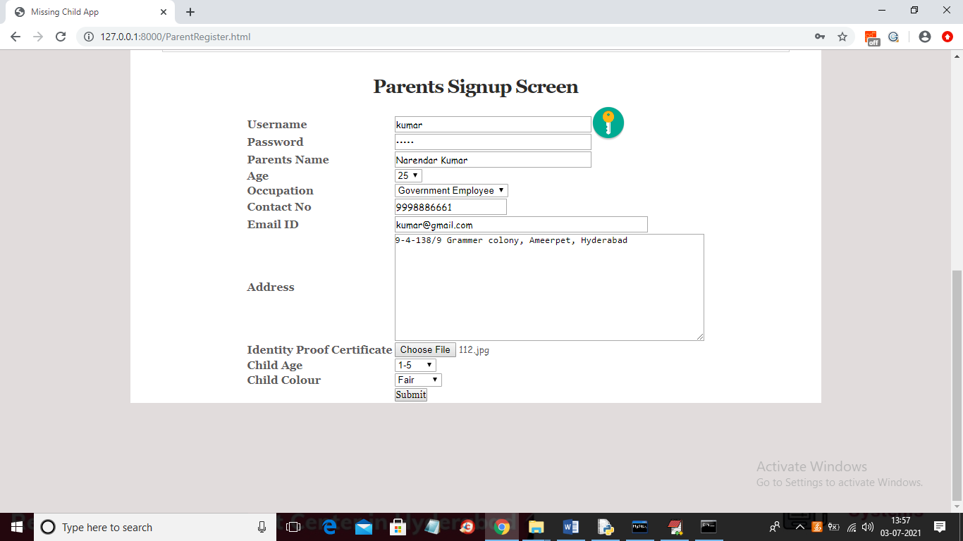

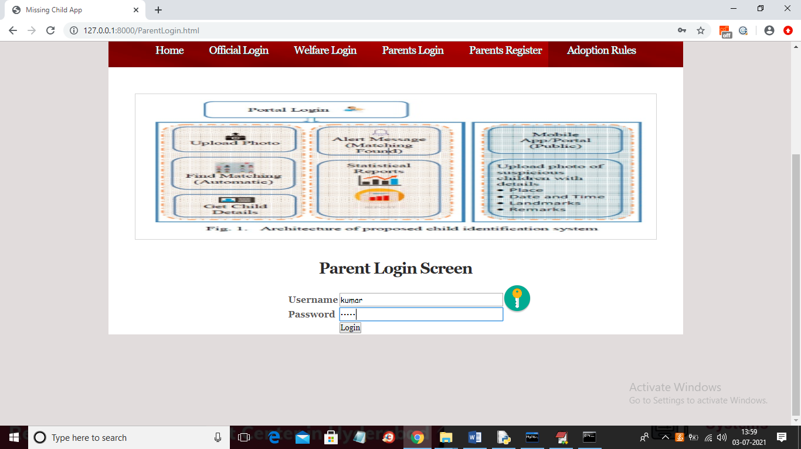

Slide 24
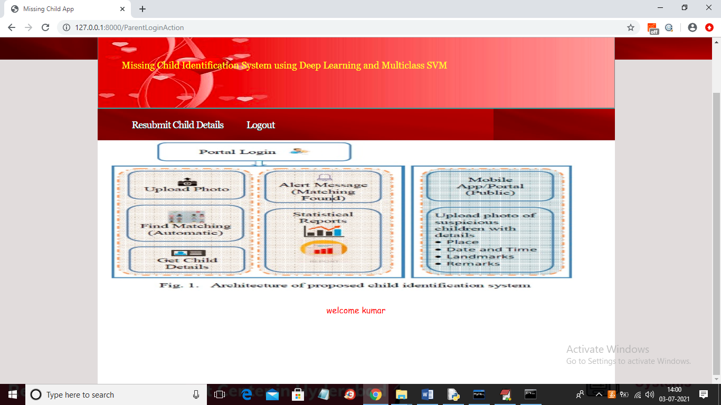
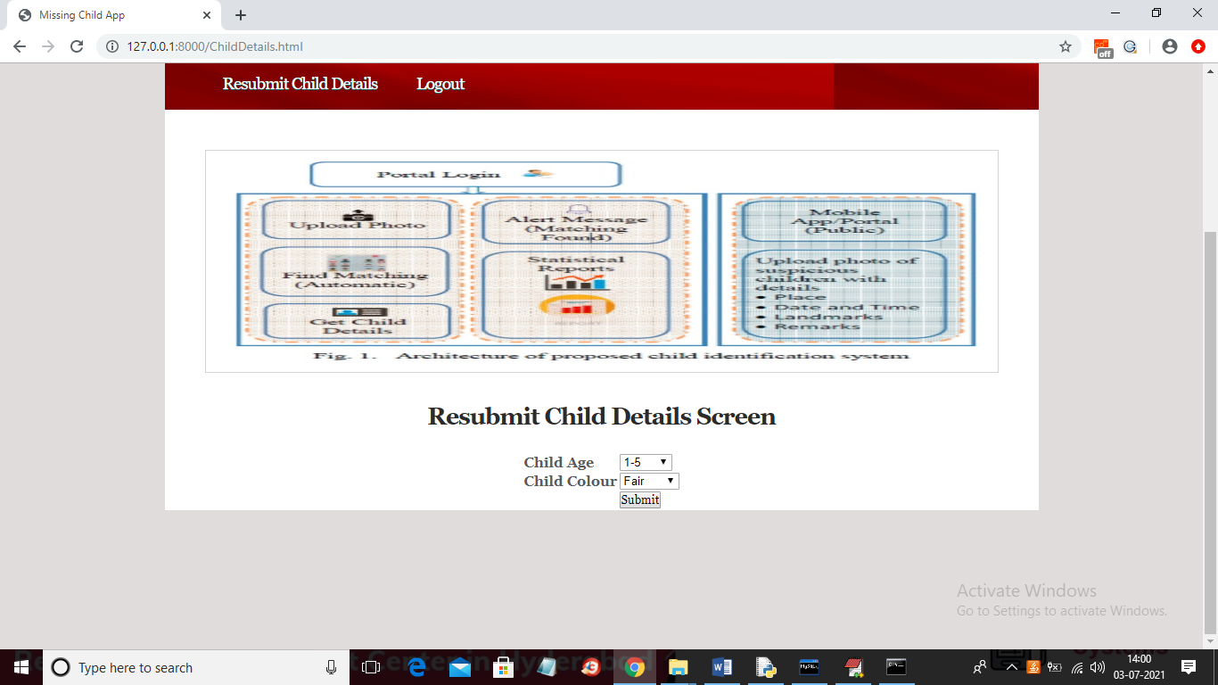
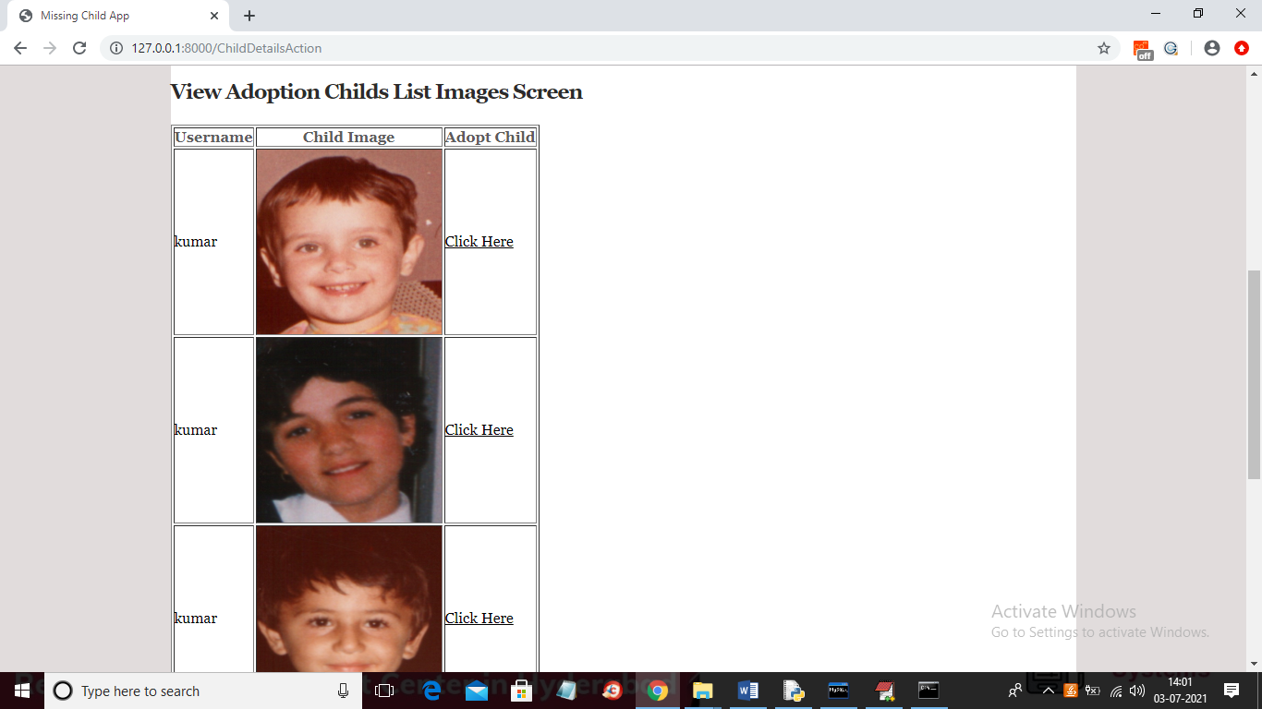
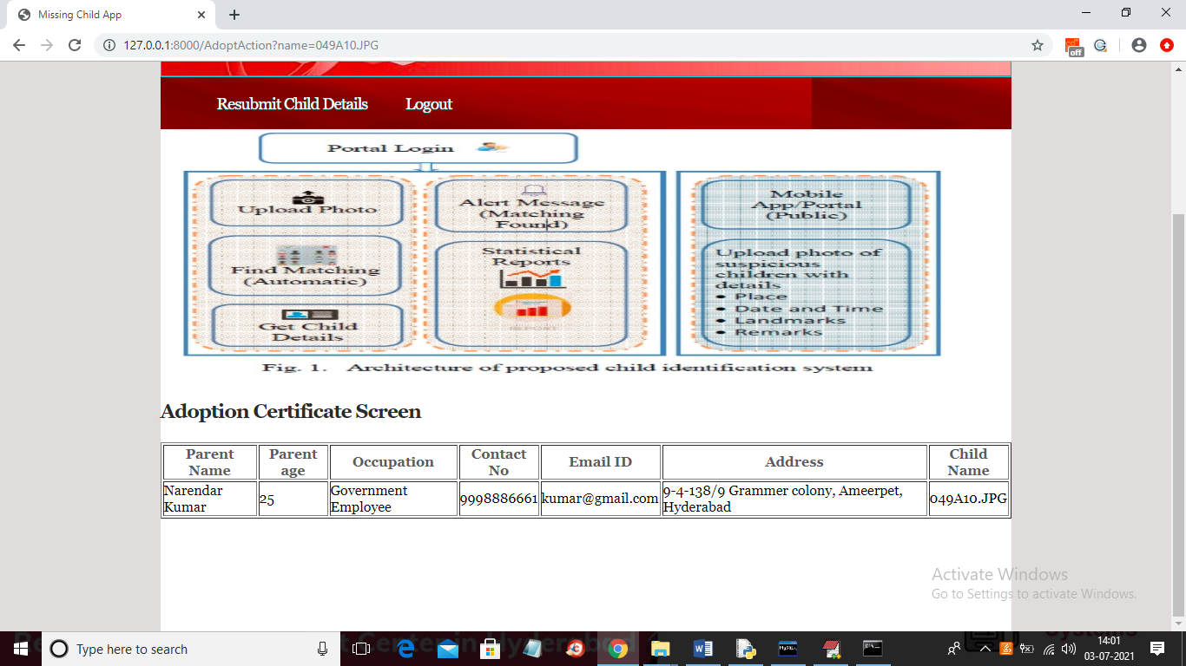

Slide 25



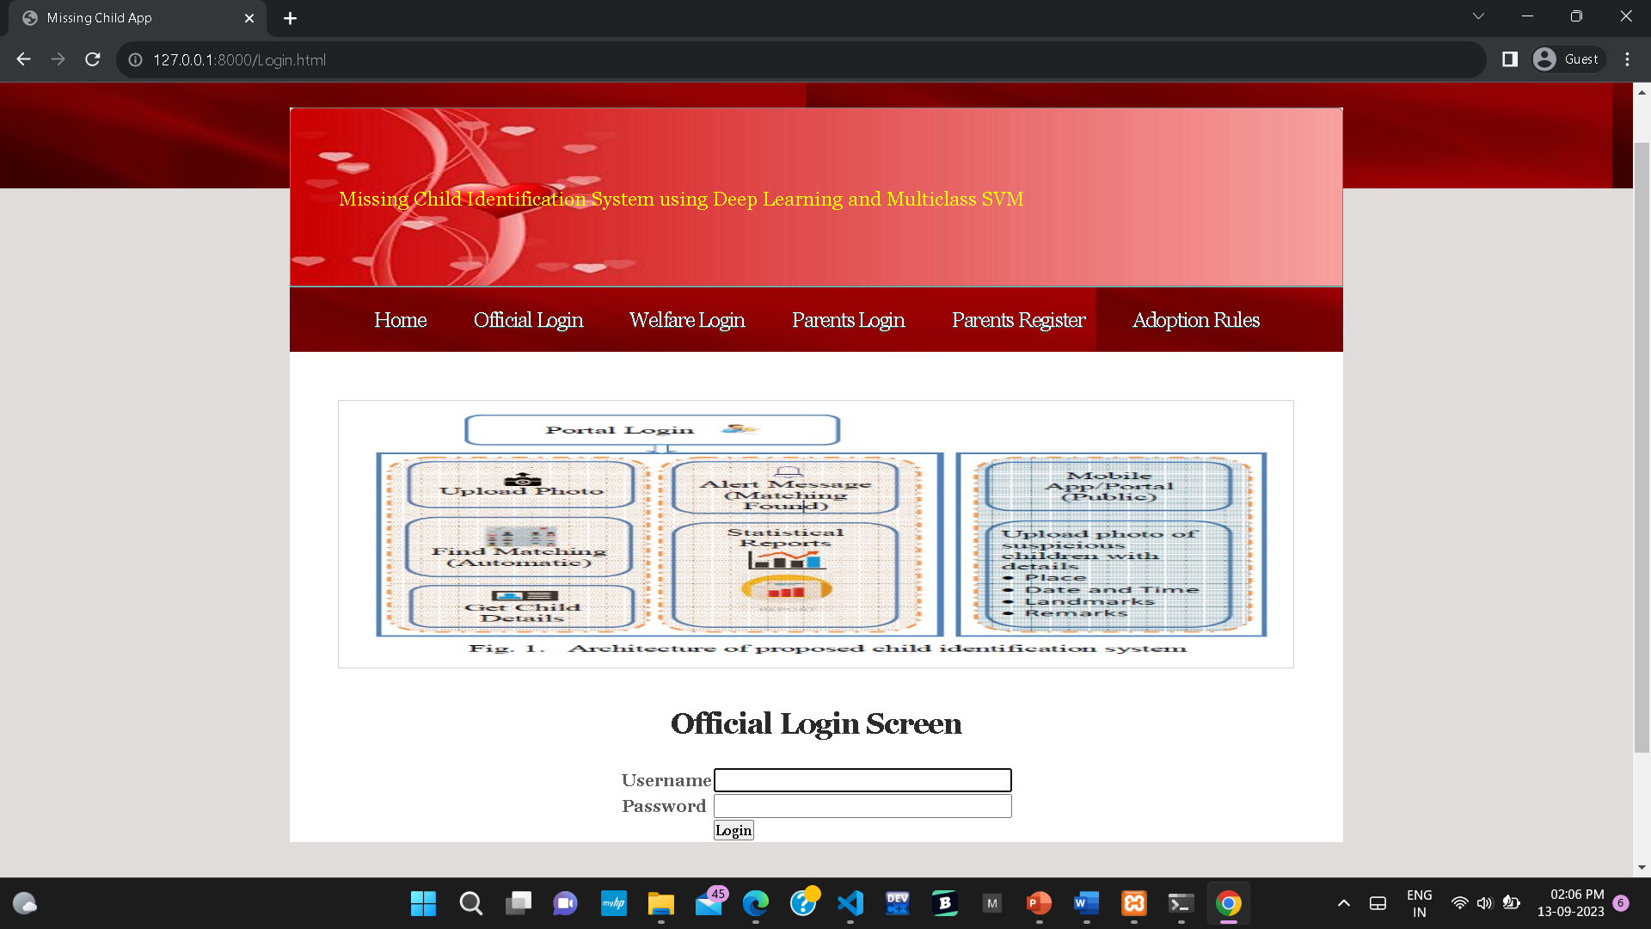

Slide 26
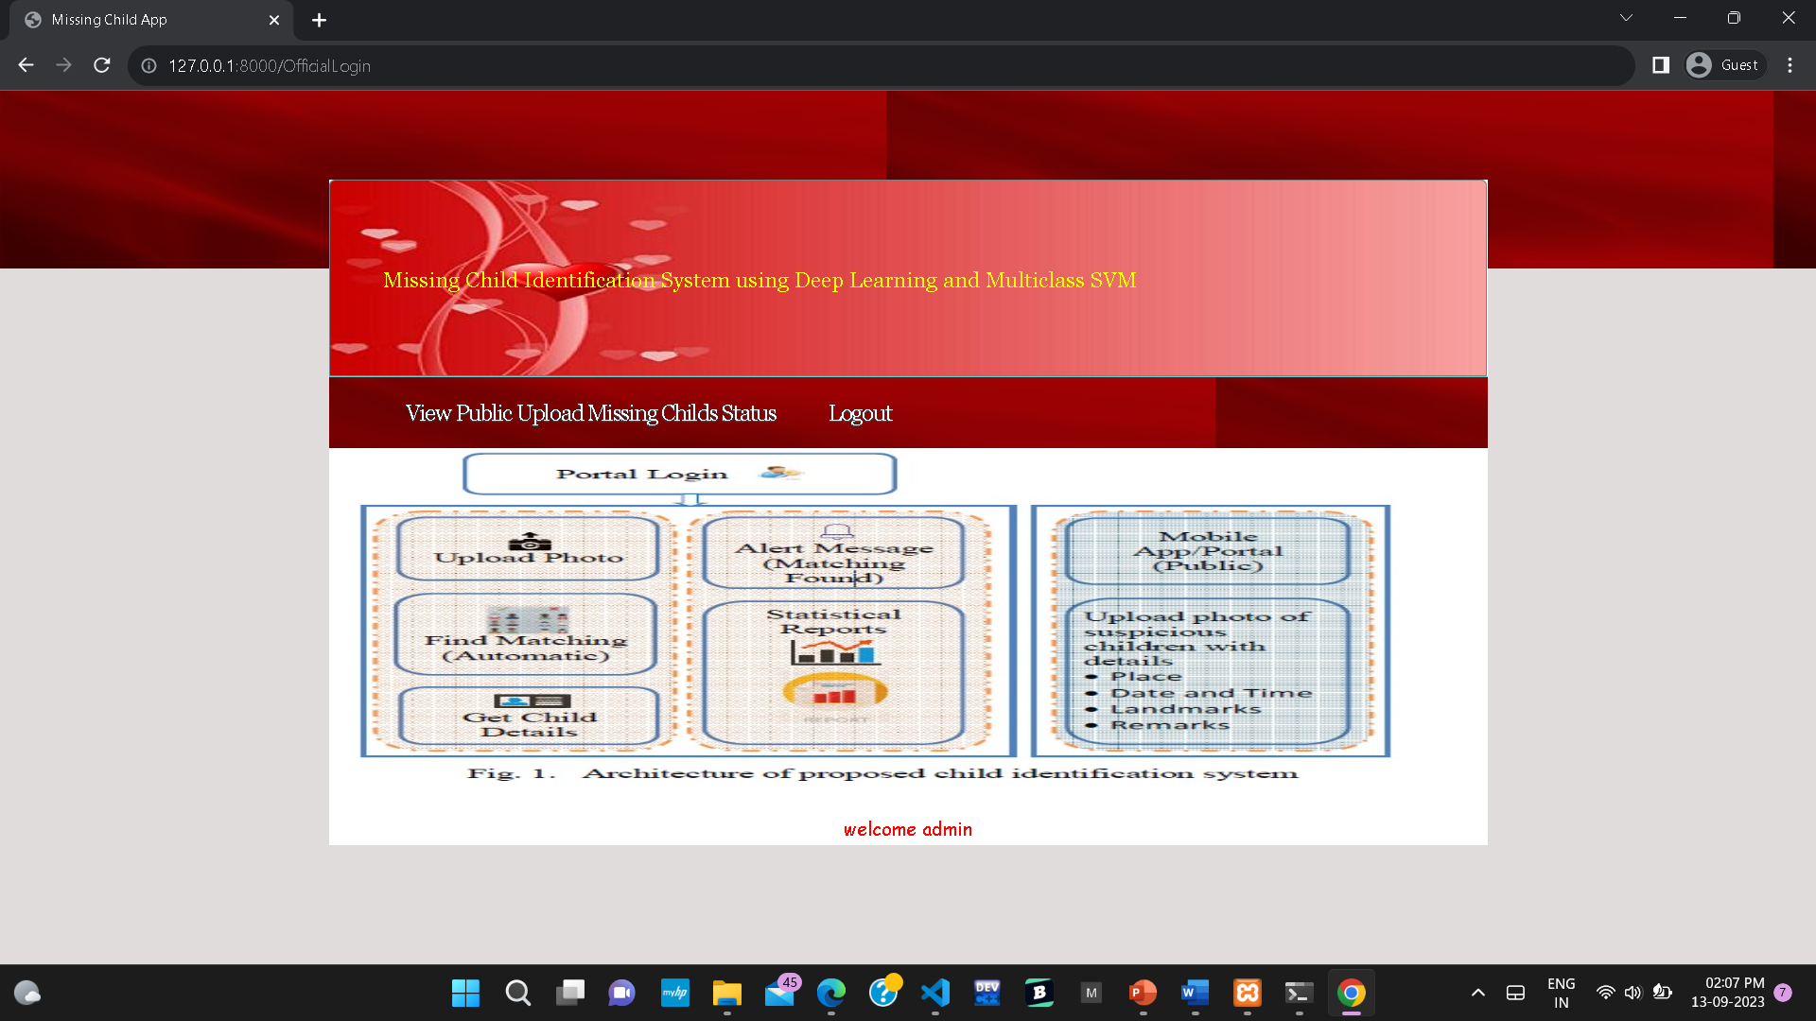
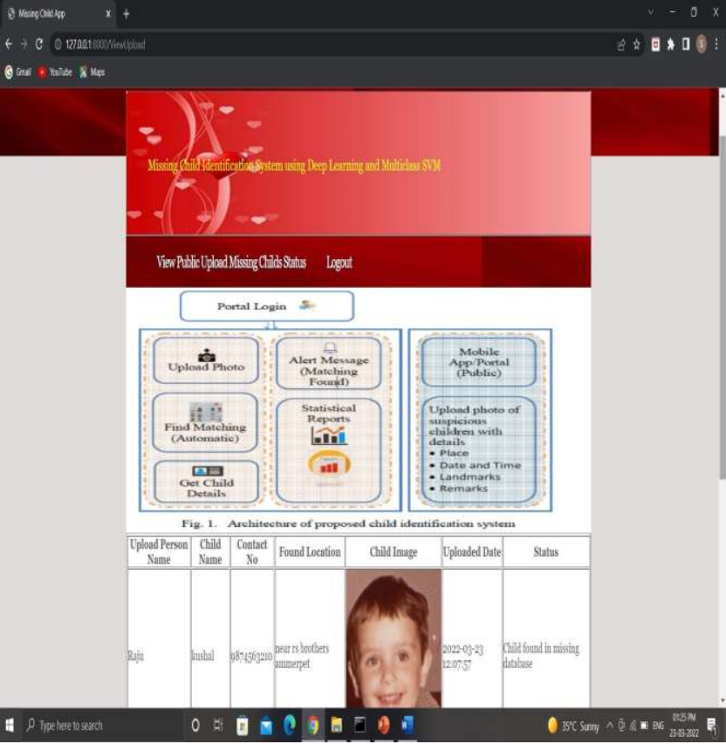

Slide 27
CONCLUSION
A missing child identification system is proposed, which combines the powerful CNN based deep learning approach for feature extraction and support vector machine classifier for classification of different child categories. This system is evaluated with the deep learning model which is trained with feature representations of children faces. By discarding the softmax of the VGG-Face model and extracting CNN image features to train a multi class SVM, it was possible to achieve superior performance.
Performance of the proposed system is tested using the photographs of children with different lighting conditions, noises and also images at different ages of children.
The classification achieved a higher accuracy of 99.41%

Slide 28
FUTURE SCOPE
In the future, planning to extend this system further by connecting our system to public cameras and detect faces real-time.
Collaboration: Partner with law enforcement agencies, NGOs, and other relevant organizations to make the system widely accessible and to increase the chances of reuniting missing children with their families.
Ensemble Learning : Combine the predictions from the deep learning model and SVM to improve accuracy and robustness. This could be done using techniques like majority voting or weighted averaging.

Slide 29
REFERENCES
Y. LeCun, Y. Bengio, and G. Hinton, "Deep learning", Nature,521(7553):436–444, 2015.
O. Deniz, G. Bueno, J. Salido, and F. D. la Torre, "Face recognition using histograms of oriented gradients", Pattern Recognition Letters, 32(12):1598–1603, 2011.
C. Geng and X. Jiang, "Face recognition using sift features", IEEE International Conference on Image Processing(ICIP), 2009.
Rohit Satle, Vishnuprasad Poojary, John Abraham, Shilpa Wakode, "Missing child identification using facerecognition system", International Journal of Advanced Engineering and Innovative Technology (IJAEIT), Volume 3 Issue 1 July - August 2016.

Slide 30
GITHUB LINK
https://github.com/burrevedika/missingchild/tree/master

Slide 31
THANK YOU

